Slide 1
UNIVERSITY INSTITUTE OF ENGINEERING
Department of Computer Science & Engineering
Databases Management System
(23CSH-205/23ITH-205)
DR. GITANJALI
E16525
ASSISTANT PROFESSOR
CSE
DISCOVER . LEARN . EMPOWER

Slide 2
ABOUT COURSE
The main DBMS course, we learn about the structural formation of data, maintain data integrity, multitasking with concurrent access and recovery without occurring crashes, data structures, data models etc. and their working in which every organization is based.
At the end of the course, the students may understand the concepts of data structures, data models and design, construction of queries by using SQL, uses and applications of database design etc

Slide 3
COURSE OUTCOMES
CO No. | Title | BT Level
CO1 | Students will be able to understand the database system concepts and design databases for different applications. | Memorize
CO2 | Students will be able to identify different types of DDL, DML, DCL and TCL commands and their usage. | Understanding
CO3 | Students will be able to classifying Normalization, Dependencies and Denormalization along with their requirements. | Apply
CO4 | Students will be able to analyse and Compare Transaction Processing techniques and Recovery techniques. | Analyze
CO5 | Students will be able to evaluate database performance after implementing Triggers, procedures, packages, cursors and views. | Evaluate
Will be covered in this lecture

Slide 4
COURSE OBJECTIVES
This course will enable students to,
To have good understanding of database system concepts and design databases for different applications.
To learn how to use a DBMS and RDBMS.
To implement and understand different types of DDL, DML and DCL statements.
To understand transaction concepts related to databases and recovery/backup techniques required for the proper storage of data.

Slide 5
Topics covered
Relational Algebra & Relational Calculus:
Introduction, Syntax, Semantics, Additional operators, Grouping and Ungrouping, Relational comparisons, Tuple Calculus, Domain Calculus, Calculus Vs Algebra, Computational capabilities.

Slide 6

Relational Algebra
Relational algebra consists of a certain set of rules or operations that are widely used to manipulate and query data from a relational database. It can be facilitated by utilizing SQL language and helps users interact with database tables based on querying data from the database more efficiently and effectively.
Relational Algebra incorporates a collection of operations, such as filtering data or combining data, that help us organize and manipulate data more efficiently. This ” algebra ” is the foundation for most database queries, and it enables us to extract the required information from the databases by using SQL query language.

Slide 7

Relational Algebra
These are the basic/fundamental operators used in Relational Algebra
Selection(σ)
Projection(π)
Union(U)
Set Difference(-)
Set Intersection(∩)
Rename(ρ)
Cartesian Product(X)

Slide 8


Relational Algebra
These are the basic/fundamental operators used in Relational Algebra
1. Selection(σ): Selection Operation is basically used to filter out rows from a given table based on certain given condition. It basically allows you to retrieve only those rows that match the condition as per condition passed during SQL Query. It is used to select required tuples of the relations.
If we want to get the details of all the work in the Department “IT”, we would use the selection operator to filter out these based on the given condition.
SELECTION

Slide 9
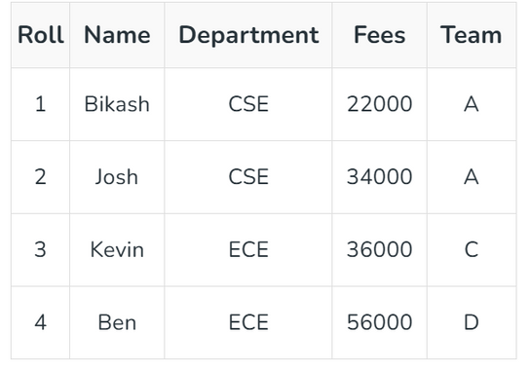

Relational Algebra
Notation: σ (R)
c
where ‘c’ is the selection condition which is a boolean expression(condition), we can have a single condition like Roll= 3 or a combination of conditions like X>2 AND Y<1, and symbol ‘σ (sigma)’ is used to denote select(choose) operator, R is a relational algebra expression, whose result is a relation.
Example:
Select all the students of Team A :

Slide 10

Relational Algebra
2. Projection(π): While Selection operation works on rows , similarly projection operation of relational algebra works on columns. It basically allows you to pick specific columns from a given relational table based on the given condition and ignoring all the other remaining columns.
Notation: π (R)
A
where ‘A’ is the attribute list, it is the desired set of attributes from the attributes of relation(R), symbol ‘π(pi)’ is used to denote the Project operator, R is generally a relational algebra expression, which results in a relation.
PROJECTION

Slide 11
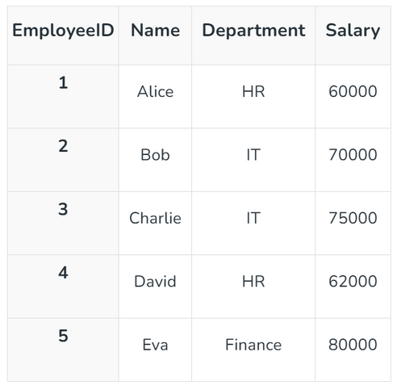

Relational Algebra
The following query retrieves only the Name and Salary columns from the Employees table:
Project operator is denoted by Pi symbol.

Slide 12
Relational Algebra
3. Union(U): Union Operator is basically used to combine the results of two queries into a single result. The only condition is that both queries must return same number of columns with same data types.
Syntax:
The Syntax of the SQL UNION operator is:
SELECT columnnames FROM table1
UNION
SELECT columnnames FROM table2;
UNION
U
Rules for SQL UNION
Each table used within UNION must have the same number of columns.
The columns must have the same data types.
The columns in each table must be in the same order.

Slide 13
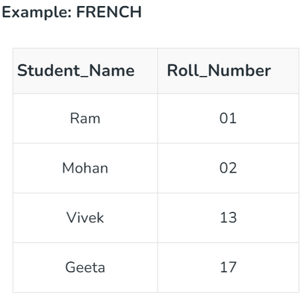
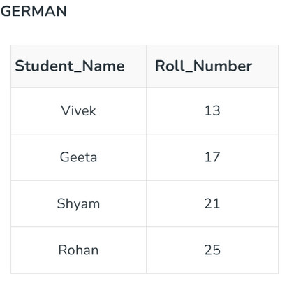
Relational Algebra
Consider the following table of Students having different optional subjects in their course.
π(Student_Name)FRENCH U π(Student_Name)GERMAN

Slide 14
Relational Algebra
4. Set Difference(-): Set difference basically provides the rows that are present in one table, but not in another tables.
Notations: A - S
where, A and S are the relations,
symbol ‘ – ’ is used to denote the Minus operator.
The result of Intersection operation, which is denoted by A – S, is a relation that basically includes all the tuples that are present in A but not in S.
SET DIFFERENCE
-

Slide 15
Relational Algebra
Example: From the given table of FRENCH and GERMAN, Set Difference is used as follows:
π(Student_Name)FRENCH - π(Student_Name)GERMAN

Slide 16
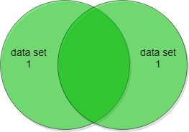
Relational Algebra
5. Set Intersection(∩): Set Intersection basically allows to fetches only those rows of data that are common between two sets of relational tables.
The INTERSECT statement will return only those rows which will be common to both of the SELECT statements.
SET INTERSECTION
U

Slide 17
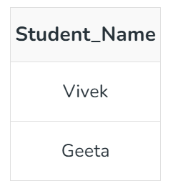
Relational Algebra
Example:
From the above table of FRENCH and GERMAN, the Set Intersection is used as follows:
π(Student_Name)FRENCH ∩ π(Student_Name)GERMAN

Slide 18

Relational Algebra
6. Rename(ρ): Rename operator basically allows you to give a temporary name to a specific relational table or to its columns. It is very useful when we want to avoid ambiguity, especially in complex Queries. Rename is a unary operation used for renaming attributes of a relation
Notation: ρ X (R)
where the symbol ‘ρ’ is used to denote the RENAME operator and R is the result of the sequence of operation or expression which is saved with the name X.
RENAME

Slide 19
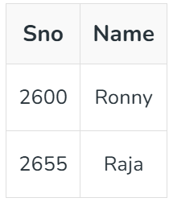

Relational Algebra
Example-1:
Query to rename the relation Student as Male Student and the attributes of Student – RollNo, SName as (Sno, Name).
Example-2:
Query to rename the attributes Name, Age of table Department to A,B.

Slide 20
Relational Algebra
7. Cross Product(X): Cartesian product Operator combines every row of one table with every row of another table , producing all the possible combination. It’s mostly used as a precursor to more complex operation like joins.
Cross-product between two relations. Let’s say A and B, so the cross product between A X B will result in all the attributes of A followed by each attribute of B. Each record of A will pair with every record of B.
Notation: A ✕ S
where A and S are the relations,
the symbol ‘✕’ is used to denote the CROSS PRODUCT operator.
CROSS PRODUCT
X

Slide 21
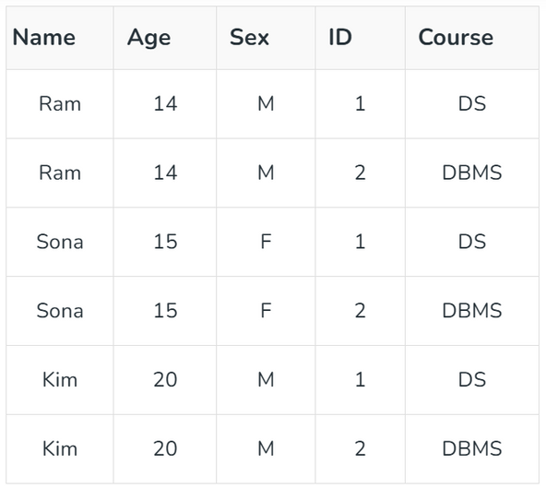
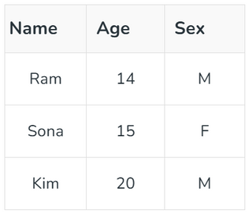
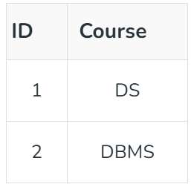
Relational Algebra
Example:
Output:
Table 1:
Table 2:

Slide 22
Relational Algebra
A Join operation is used to combine related tuples from two relations (tables) into a single relation based on a specified condition. It is one of the most commonly used operations in relational databases.
Types of Join:
Inner Join: Combines rows with matching values in both tables.
Conditional Join: Matches rows based on a specified condition.
Equi Join: Matches rows where values in specific columns are equal.
Natural Join: Automatically matches rows based on common column names.
2. Outer Join: Includes matching and non-matching rows from one or both tables.
Left Outer Join: Includes all rows from the left table and matching rows of right.
Right Outer Join: Includes all rows from the right table and matching rows of left.
Full Outer Join: Includes all rows from both tables, with NULLs for non-matches.

Slide 23
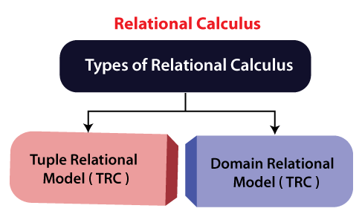
Relational Calculus
As Relational Algebra is a procedural query language, Relational Calculus is a non-procedural query language. It basically deals with the end results. It always tells me what to do but never tells me how to do it.
There are two types of Relational Calculus
Tuple Relational Calculus(TRC)
Domain Relational Calculus(DRC)
DRC

Slide 24
Relational Calculus
Tuple Relational Calculus (TRC) is a non-procedural query language used in relational database management systems (RDBMS) to retrieve data from tables. TRC is based on the concept of tuples, which are ordered sets of attribute values that represent a single row or record in a database table.
TRC is a declarative language, meaning that it specifies what data is required from the database, rather than how to retrieve it. TRC queries are expressed as logical formulas that describe the desired tuples.
Syntax:
The basic syntax of TRC is as follows:
{ t | P(t) }
where t is a tuple variable and P(t) is a logical formula that describes the conditions that the tuples in the result must satisfy. The curly braces {} are used to indicate that the expression is a set of tuples.
Tuple Relational Calculus (TRC)

Slide 25
Relational Calculus
Domain Relational Calculus is a non-procedural query language equivalent in power to Tuple Relational Calculus. Domain Relational Calculus provides only the description of the query but it does not provide the methods to solve it. In Domain Relational Calculus, a query is expressed as,
{ < x1, x2, x3, ..., xn > | P (x1, x2, x3, ..., xn ) }
where, < x1, x2, x3, …, xn> represents resulting domains variables and P (x1, x2, x3, …, xn ) represents the condition or formula equivalent to the Predicate calculus.
Domain Relational Calculus (DRC)

Slide 26
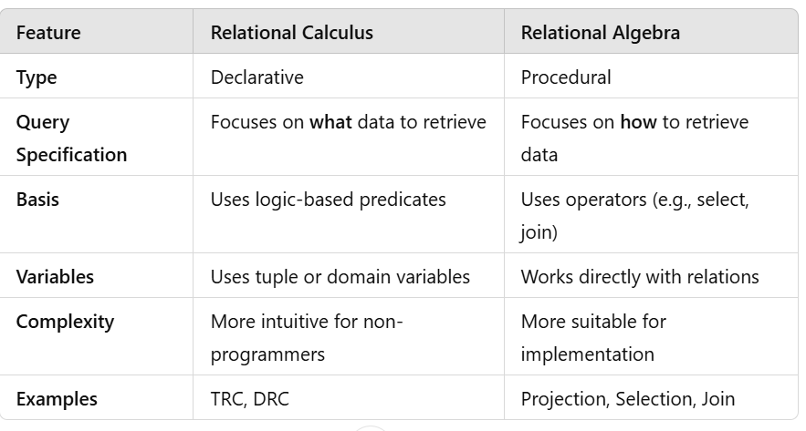
Calculus Vs Algebra

Slide 27
Grouping and Ungrouping in Relational Databases
1. Grouping
Grouping is a process of aggregating rows in a relation based on one or more attributes and then performing aggregate operations like SUM, COUNT, AVG, MAX, or MIN on them.
Purpose
To summarize or condense data.
Commonly used for generating reports or statistical analysis.
Syntax
Grouping in extended relational algebra can be represented using a GROUP operator:
GROUP_BY(attributes, aggregate_function(attribute))(relation)

Slide 28
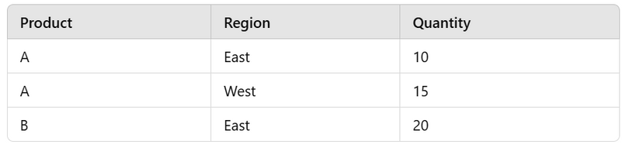
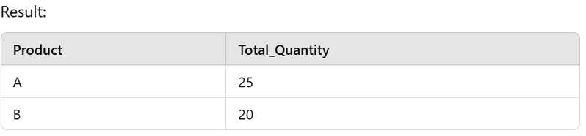
Grouping and Ungrouping in Relational Databases
If we want to find the total quantity sold for each product:
GROUP_BY(Product, SUM(Quantity))(Sales)

Slide 29
Grouping and Ungrouping in Relational Databases
Aggregate Functions:
SUM: Adds up values in a group.
COUNT: Counts the number of rows in a group.
AVG: Computes the average value in a group.
MAX/MIN: Finds the maximum/minimum value in a group.

Slide 30
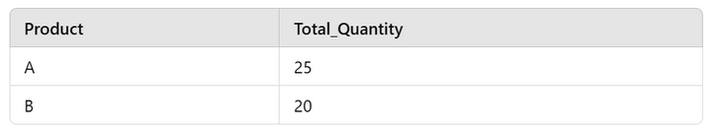
Grouping and Ungrouping in Relational Databases
2. Ungrouping
Ungrouping is the reverse process of grouping, where aggregated data is broken down into individual rows or components.
Purpose
To expand summarized data back to its detailed representation.
Useful for reconstructing the original dataset from grouped data.
Example
Given the grouped relation:

Slide 31
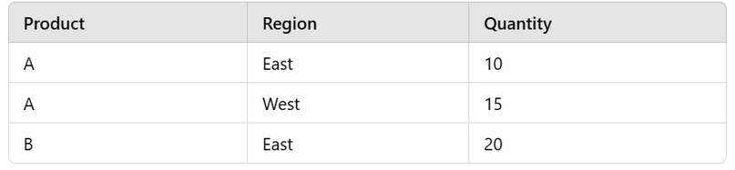
Grouping and Ungrouping in Relational Databases
And the original relation Sales:
We can "ungroup" the data by rejoining the grouped relation with the original using the Product attribute.

Slide 32
Grouping and Ungrouping in Relational Databases
Practical Use Cases
Grouping:
Finding total sales per region or product.
Calculating average salary by department.
Summarizing inventory by category.
Ungrouping:
Expanding summarized sales reports back into individual transactions.
Analyzing aggregated metrics at a granular level.

Slide 33

Relational Comparisons
Relational comparisons in databases involve evaluating relationships between data attributes or between tuples in a relation. These comparisons are typically used in query conditions to filter, join, or manipulate data.
Relational comparisons compare values in tuples or attributes using comparison operators such as =, <, >, <=, >=, <>.

Slide 34
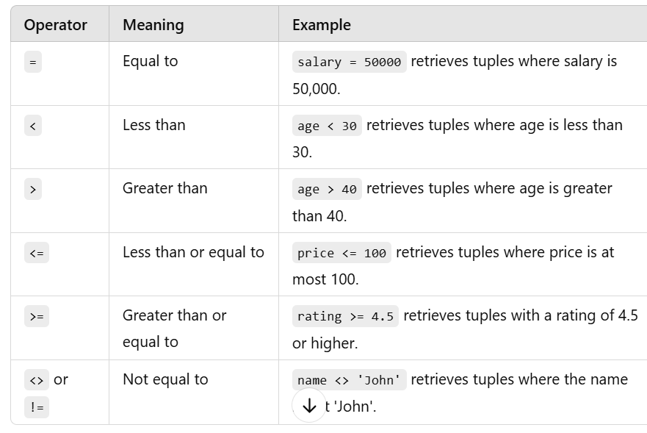
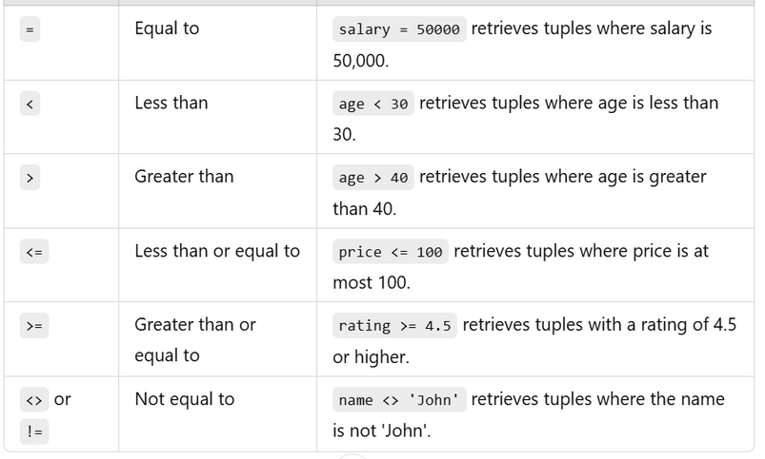
Relational Comparisons

Slide 35
Computational Capabilities
Computational Capabilities:
Expressive Power
Both Relational Algebra and Relational Calculus are equivalent in terms of computational capabilities. Codd’s Theorem proves this equivalence.
Efficiency
Relational Algebra provides a procedural approach, making it better suited for optimization and implementation in database management systems (DBMS).
Relational Calculus, being declarative, is more user-friendly for expressing complex queries without concern for execution.
Query Optimization
DBMS converts declarative queries (Relational Calculus) into procedural queries (Relational Algebra) for optimization and execution.
Safety
Calculus expressions must be safe, ensuring that the query produces a finite result.

Slide 36
THANK YOU

